Slide 1
Full Stack Web development
Lecture 5: GitHub, IDEs, Linters, and Troubleshooting

Slide 2
Today:
Git
Integrated Development Environments (IDEs)
Linters
Troubleshooting HTML and CSS using Browser Web Development Tools

Slide 3
Git
Version Control System
What does that mean?
Why do we need it?
Tracks changes by one or more users
Is Git the only option?
SVN
Mercurial
What is GitHub and how is it different from Git?
SaaS (software as a service)
Free for individuals
Free for open-source projects
Common Terms:
Repository – collection of files and folders that make up a single project
Branch – an active line of development. A repository can have many branches
Commit – a single set of code changes that usually are tied to a feature or bug fix.
Checkout – switching to a specific branch
Clone – copying a branch of a repository to a computer or remote server.

Slide 4
Git – Getting Started - Option 1
Install Git on your computer (https://git-scm.com/book/en/v2/Getting-Started-Installing-Git)
Create an account at GitHub (https://github.com/join)
Create a new directory on your PC called ECC-Webdev-Task1*
Create a new repository on GitHub (best to keep the same name but not required)
Initialize the repository on your computer
echo "# ECC-WebDev-Task1" >> README.md git init git add README.md git commit -m "first commit" git remote add origin https://github.com/<USER>/ECC-WebDev-Task1.git git push -u origin master
*Repository name is just a suggestion, name it whatever you like

Slide 5
Git – Getting Started – Option 2
Install Git on your computer (https://git-scm.com/book/en/v2/Getting-Started-Installing-Git)
Create an account at GitHub (https://github.com/join)
Create a new repository on GitHub called ECC-Webdev-Task1*
Be sure to add a README
Clone the new repository onto your PC
git clone https://github.com/<USER>/ECC-WebDev-Task1.git
*Repository name is just a suggestion, name it whatever you like

Slide 6
Git – Making a Commit
Create a new file, or copy one of our previous files into your folder where you setup the Git repository
git status –Shows you if there are any changes that need to be added.
git add FILENAME –adds the file listed to be ready to commit
git commit -m ”add new file" – creates the commit
git push -u origin master – push change to remote branch (GitHub)

Slide 7
Git – A Word of Caution
These two lines:
git add FILENAME –adds the file listed to be ready to commit git commit -m ”add new file" –creates the commit
Can be combined into:
git commit –am “add new file”
The –a flag means add ALL changed files to the commit. Use this with caution as it can cause you to commit files you do not intend to!

Slide 8
Git – Pulling In Changes
If someone else is working on the same codebase, or you are working from a different computer, you always want to pull down the most recent changes before making your own.
git pull –p
This pulls down changes from the remote branch you are working on.
Note on –p: this flag tells git to clean up any dead branches; branches that only exist locally and not on the remote

Slide 9
Git – Creating a new branch
If there are a lot of changes you want to make to the code, but you don’t want them to go into master until they are built and tested (this is the correct way.. hint.. hint..), you create a new branch.
git checkout –b branch-name
This creates a new branch based on the current branch that you can commit code to.

Slide 10
Git – Creating a new branch cont.
When to create a new branch
Adding a feature
Making a large change that will need to be tested
Fixing/Testing a bug that can upset application stability
Branch naming
Working on an issue ticket? Put it in the branch name
Never use something generic like new-branch or branch-1
Branch prefixes:
bugfix/<ticket-number>-<description-of-bug-or-title-of-ticket>
feature/<ticket-number>-<feature-name>
hotfix/<ticket-number>-<title-of-ticket>

Slide 11
Git – Switching branches
Sometimes it makes sense to have different branches, but you want to switch between them.
git checkout dev
git checkout main
The first command switches to the dev branch, the second command switches back to main.

Slide 12
Git – Merging branches
The easiest way to merge branches is to do it on the command line
Merging dev branch INTO master:
git checkout master
git merge dev
git push
The first command switches to the master branch, the second command merges dev into the master branch and the third command pushes the merge to GitHub.

Slide 13
Git – Merging branches with Pull Requests
Another way, the preferred method is to create a Pull Request.
A pull request or PR allows for code review and clean merging
Most repository sites have this option (if they don’t, go somewhere else)
Cool! But Why?!
Accountability: everyone checks for errors (code review)
Security: dangerous vulnerabilities should be caught in the branch not in the main trunk which might sneak into production
Stability: new features or fixes can be tested and tried on a branch BEFORE being merged into main, thereby protecting from possibly unstable code sneaking into a different branch

Slide 14
Git – Merging branches with Pull Requests
Got it!! So how?!?
Create a branch
Make changes
Push branch to remote
Site dependent but usually either the git message returned from the remote will provide a link OR open the remote repo site (github.com/user/reponame) navigate to either the branch or pull request section and create a new one.
DEMO TIME!!

Slide 15
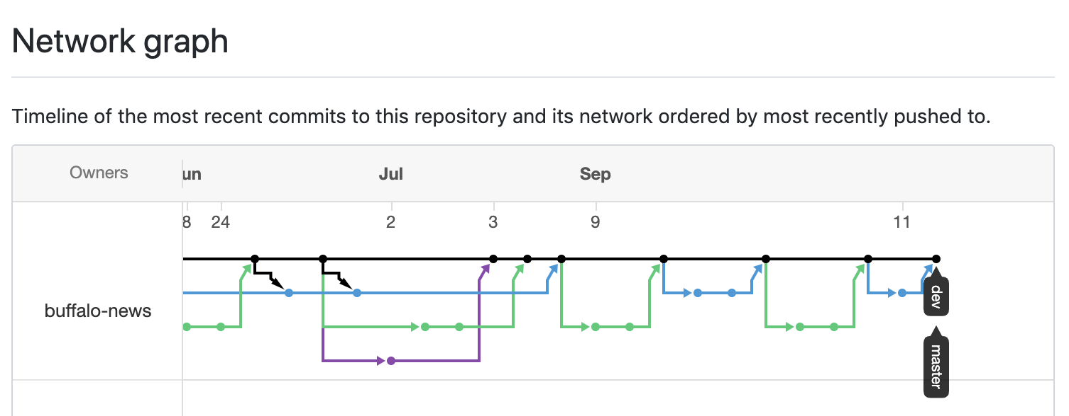
Git Workflow

Slide 16
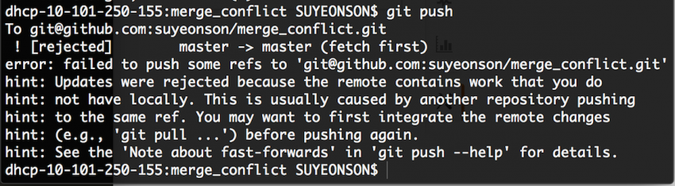
Git – Merge Conflicts
If you change the same file on two different branches, and then you try to push your commit to GitHub, you create a merge conflict that git cannot resolve.

Slide 17
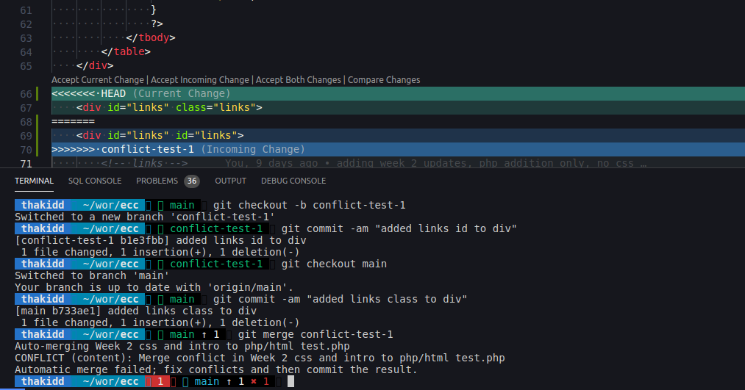
Git – Merge Conflicts

Slide 18
Git – Fixing Merge Conflicts
Finding and fixing merge conflicts
git status
Find the file(s) labeled ‘both modified’
Search for <<<<<<< HEAD
Update with correct changes
git add FILENAME
git merge --continue
Push the changes
DEMO

Slide 19
Integrated Development Environments (IDEs)
An integrated development environment is a tool used in development that helps you to program more efficiently and to help find errors more quickly.
In this class we use VSCode, however today (and only today) I will talk about and explain some others, as well as speak to the differences.

Slide 20
VSCode
Demo
Plugins
Packages
Projects
Terminal
Git Integration

Slide 21
Other IDEs
Eclipse
Open source
Popular for many different languages
Runs on java so it can eat up ram
Android Studio
Useful for building Android apps
Xcode
Popular for developing IOS apps
Visual Studio
Useful for Microsoft development
Paid version of VSCode.
IntelliJ
Java IDE
PyCharm
Python IDE
PHPStorm
PHP IDE
Atom
Basic fast text editor
Created by GitHub
Notepad++
Similar to Atom

Slide 22
LINTERS
A linter is a special IDE plugin that helps analyze source code in real-time and find syntax and stylistic bugs.
Extremely useful on teams in order to ensure coding standards
Coding Standards
Tabs vs Spaces
Correct indenting of tags
Capitalization and case structure
DEMO VSCode Linters

Slide 23
Troubleshooting – Developer Tools
Troubleshooting code is one of the hardest jobs we face as developers. We spend hours writing code and then when we test things don’t work correctly. Browser based developer tools are key to that troubleshooting process and can save you hours of work down the road.
Demo - Troubleshooting on your own, Guess/Test method.
Chrome Developer Tools Demo
Firefox has a very similar option also

